Slide 1
CBB 752 Final Project 1.2 Yale University

Slide 2
Compare the variants in Carl’s genome with those found in the GTEx database. Use the results to predict gene expression in various tissues and better estimate the impact of noncoding variants in Carl’s genome.

Slide 3
Writing
Describe eQTLs and the GTEx database. How was the data present in GTEx generated and what scientific questions does it help answer?

Slide 4
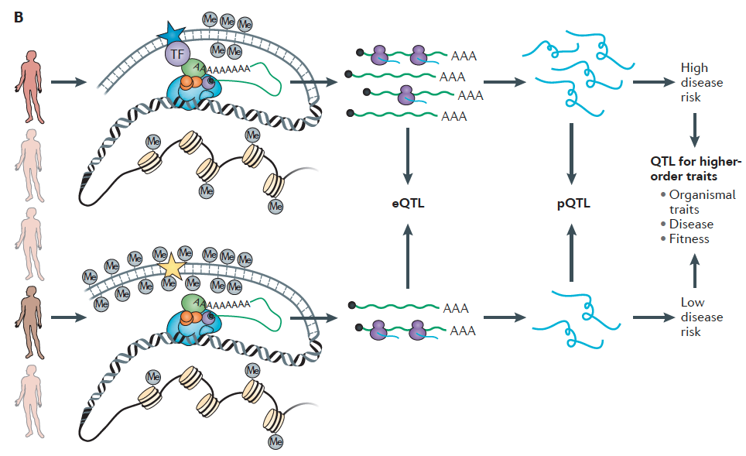

Slide 5
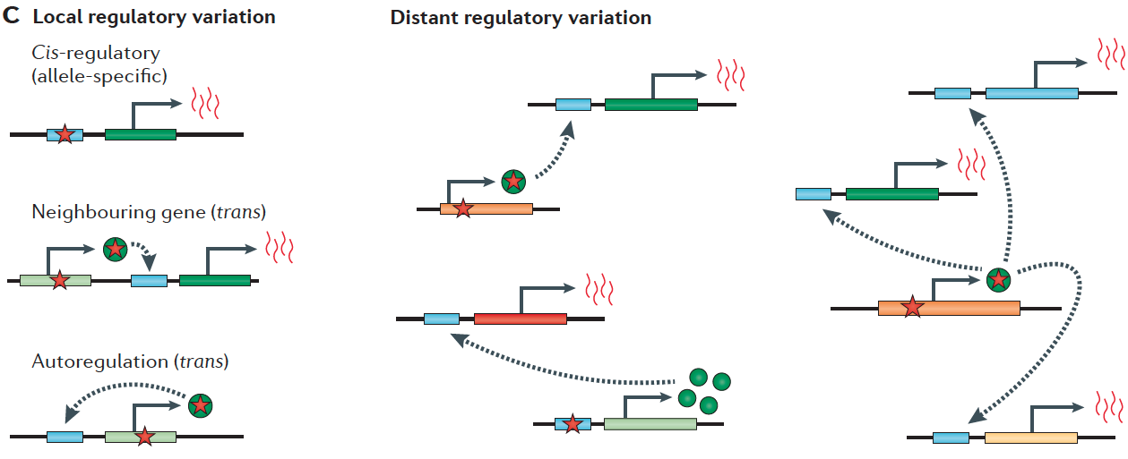

Slide 6
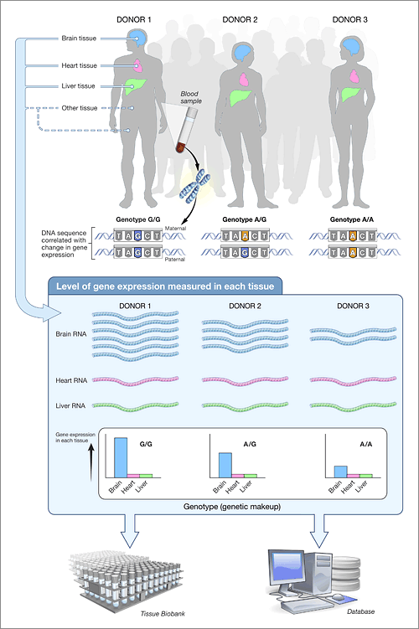

Slide 7
Identifying eQTLs in the Zimmerome
Combine genetic information (SNPs) and known eQTL sites (GTEx)
Determine whether Carl possesses any of the variants of interest, which could influence protein amounts
Generate predictions – Not confirmed without individual RNA-seq data

Slide 8
Brief Introduction: Coding
Read in Zimmerome SNPs
Find the overlapping SNP-gene-tissue pairs between Zimmerome SNPs and GTEx eQTL database
Print out the overlapping SNP-gene-tissue pairs, intersection and statistics
Final1-2.2.py, final1-2.2.3.py, final1-2.x.py

Slide 9
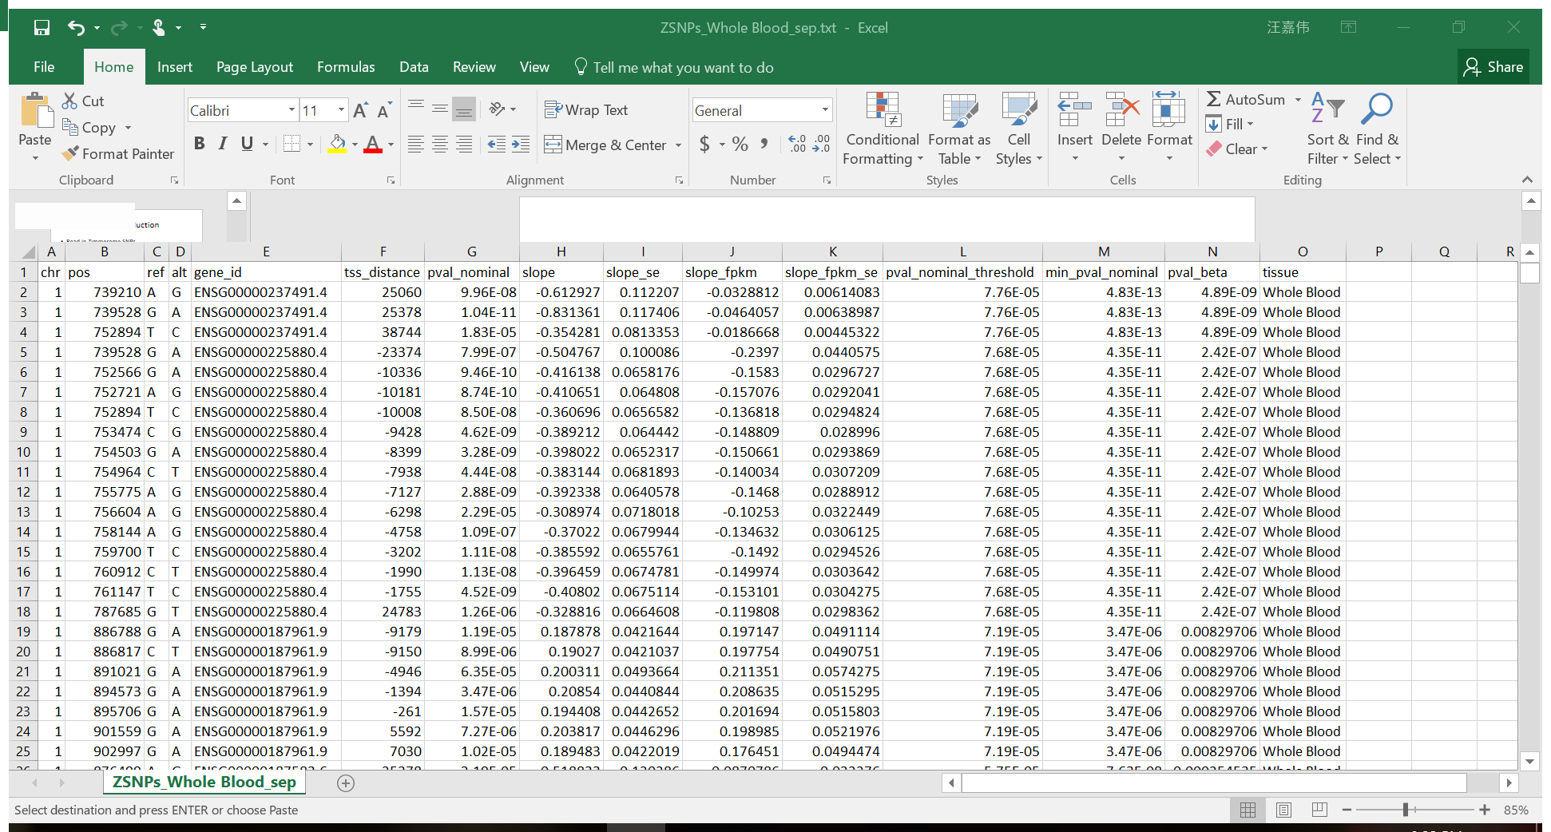
Result example

Slide 10
Summary statistics
Tissue | #Z eQTLs | #total eQTLs | %GTEx | %Coverage | %Common
Adipose Subcutaneous | 137526 | 1311216 | 10.5 | 3.93 | 15.2
Brain Cortex | 125373 | 154580 | 81.1 | 3.59 | 7.4
Liver | 74823 | 189024 | 39.6 | 2.14 | 11.2
Pancreas | 231229 | 526676 | 43.9 | 6.61 | 5.4
Whole Blood | 448413 | 1060536 | 42.2 | 12.8 | 4.3
Notes:
Most of the SNPs are not eQTLs, to current understanding
Tissue specificity
Brain tissues shares most common eQTLs: conserved and important
Whole blood shares the highest percentage of common eQTLs: blood connects the whole body
Zimmerome or not: blood related eQTLs may have the biggest influence on biology, since highest coverage

Slide 11
Pipeline
Process the variants in Carl’s genome to identify any eQTLs. Look at multiple tissues (make sure to include tissues that might be able to be tested in a noninvasive manner e.g. blood).
Yuyang Liu

Slide 12
eQTLs identified in different tissues

Slide 13
eQTL Chromosome Distribution
Notes:
Put these on one slide – quickly mention the eqtl distribution in a few tissues

Slide 14
A hotspot of eQTL on Chromosome 6

Slide 15
Distribution of cumulative effector size

Slide 16
Sample GO analysis--pancreas

Slide 17
Regulome DB analysis
First 3x10⁶ nucleotide on chromosome 1 as input dataset
Score higher than 1f are classified as eQTL

Slide 18
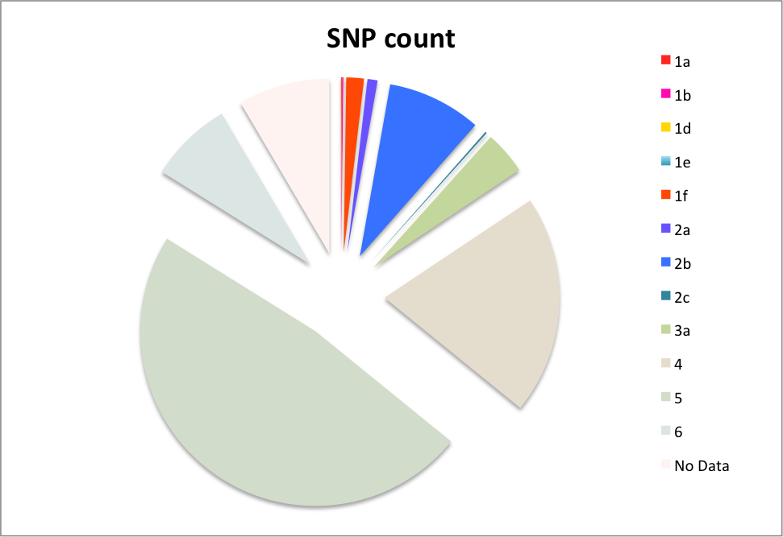
RegulomeDB scores

Slide 19
Example eQTL: rs1886730
Score 1b
Affects expression of TNFRSF14 in lymphoblastoid
http://www.regulomedb.org/snp/chr1/2488607

Slide 20
http://www.regulomedb.org/snp/chr1/2488607

Slide 21
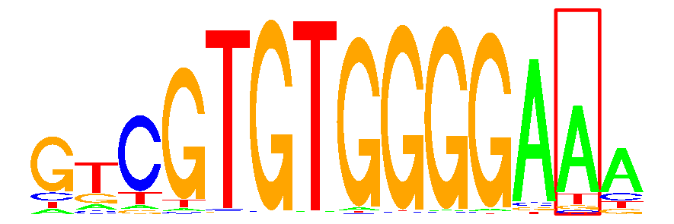
Located within the binding site of FOXO6
Evidence from multiple ChIP-Seq experiments
Near active RSS
http://www.regulomedb.org/snp/chr1/2488607

Slide 23
Correlation between eQTLs predicted by two methods
Notes:
Conclusion: moving forward, if carl does an rna seq experiment it might be neat to compare the predictions to reality

Slide 24
Summary
Zimmerome SNPs are interestingly enriched in immune-related chromosome regions
A small proportion of SNPs serve as eQTLs and regulate the expression of genes (mainly in the immune system)

Slide 25
Thank you!

Slide 26
Supplement

Slide 27
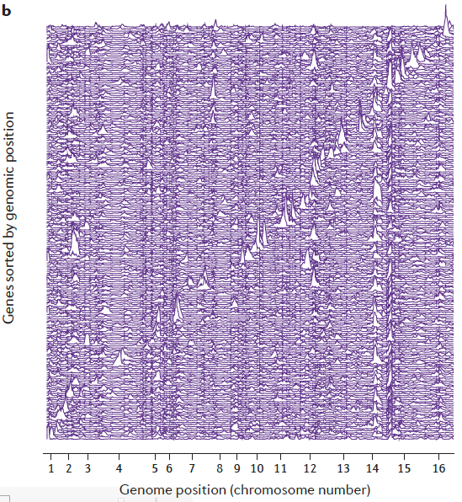
Notes:
Move to supplement

